Slide 1
CRDs, No Longer 2nd Class Thing!
Jing Xu (Google) and Xing Yang (OpenSDS)

Slide 2


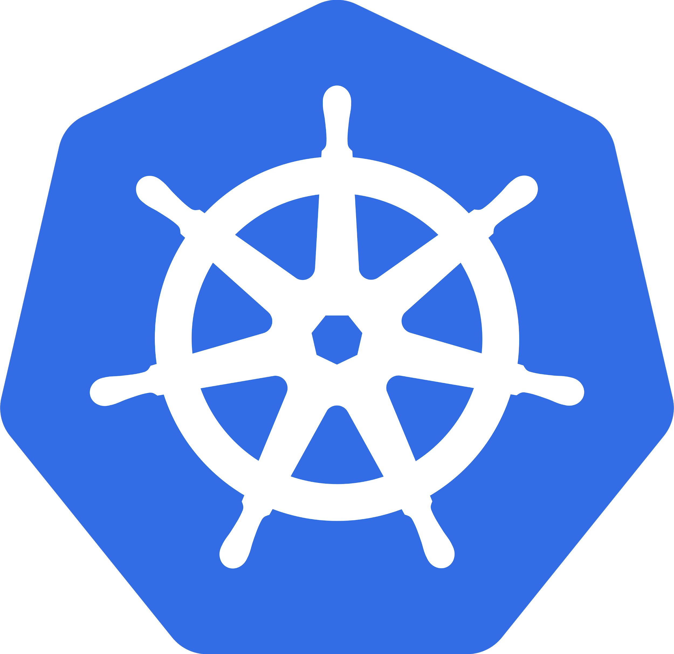
Google Software Engineer
GKE Storage-lifecycle Team
Kubernetes Sig-Storage: Snapshot Workgroup Lead
Email: jinxu@google.com
OpenSDS Lead Architect
Kubernetes Sig-Storage:
Snapshot Workgroup Lead & CNCF Storage SIG Tech Lead
xingyang105@gmail.com
Notes:
Jing: Hello everyone, I’m Jing. I work for the Kubernetes Storage lifecycle team at Google.
This is Xing. Shen is the Lead Architect of OpenSDS, an open source project under Linux foundation.
We are leading the Snapshot working group.
Xing: 大家好，我是杨星。我是OpenSDS的首席架构师。OpenSDS 是 Linux基金会下的一个开源项目，它的目的是要解决云原生环境里存储集成方面的困难。
这是徐菁。她是谷歌GKE 存储管理团队的工程师。
我们都是kubernetes 社区的贡献者。一起主导存储快照小组的工作。
今天我们很荣幸有机会在这里给大家演讲.
我们会用英文来演讲, 欢迎大家随后用中文和我们交流
Today we are going to talk about CRD. What is CRD, why it is important to talk here? To explain it, we first want to share a story, a story from our own experience which inspired this talk.
Provide the best portable file and block storage control-plane APIs to simplify running containerized workloads.
Provide (build, deliver, manage) a system that implements these APIs in a highly secure, automated, enterprise available, scalable manner.

Slide 3

Our CRD Journey Begins...
Volume Snapshot Project
Notes:
Source: https://cloud.netapp.com/blog/snapshots-technology-cloud-volumes
2 min
Jing 1
Our story started a year ago when Xing and I started working on snapshot feature. As you know, we both work on storage, and storage is for storing data and data is so precious, no one want to lose it. However the world is not perfect. Disk might fail, data might be corrupted, human make mistakes too. With snapshot, it’s like taking a picture of your data, and then you can recover it to the same thing when you take the snapshot.. We were very excited, you know, it is such an important feature that many customers depends on.
Source: Disaster Recovery Preparedness Council (2014 DR Benchmark Survey)
We presented our ideas to SIG-Architecture
Our design proposal was to add snapshot API and controller into Kubernetes Core.
Benefits of in-tree vs cons of out-of-tree …...

Slide 4

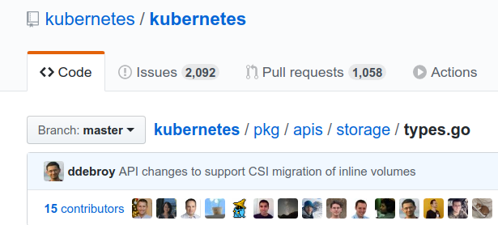
API Core
type VolumeSnapshot struct {
metav1.TypeMeta
metav1.ObjectMeta
Spec VolumeSnapshotSpec
Status VolumeSnapshotStatus
}
Notes:
Jing 1
Our story started a year ago when Xing and I started working on snapshot feature
We presented our ideas to SIG-Architecture add into the core, so users can use them as like pods, statefulsets
Our design proposal was to add snapshot API and controller into Kubernetes Core.
Benefits of in-tree vs cons of out-of-tree …...

Slide 5

PLEASE USE CRD
Architecture Special Interest Group
Notes:
Jing 1/6
They told us to use CRD instead.
But, the story does not go as we expected. They said no, they told us to use CRD instead.
https://pngimage.net/no-cartoon-png-5/

Slide 6

PLEASE USE CRD
Architecture Special Interest Group
Notes:
Jing
At that time we wondered Why? We had many questions at that time.
Why do they try to push us out of tree and use CRD
Does that mean snapshot feature is not as important as core API?, not considered a core k8s function
We have lots of questions
Jing: We tried very hard, hoping to change their mind. Xing, Do you remember that?
-------------------------------
Xing: Of course, I remember that, Jing. we thought of so many different ways to prove that snapshot API should stay in-tree and that sig-architecture was wrong.
But after many rounds of discussions, we finally changed our mind and agreed with their decision.
-------------------------------
https://pngimage.net/no-cartoon-png-5/

Slide 7

Kubernetes Grows Fast
2014
2015
2016
2017
2018
2019
Birth
1.0 Release
~1.5 Release
~1.9 Release
~1.13 Release
~1.15 (6, 7, …)
Notes:
Xing: To understand from sig-architecture’s point of view, let us go back in time, to the early days of Kubernetes
In 2014, the 1st PR was submitted in the Kubernetes repo. K8S was born.
In 2015 we had the 1.0 release
---------------------------------
Five years ago, Kubernetes was released into the world. Just like this baby boat, it was small, limited in functionality, and had only a few people involved in its creation

Slide 8

Kubernetes Grows Fast
2014
2015
2016
2017
2018
2019
Birth
1.0 Release
~1.5 Release
~1.9 Release
~1.13 Release
~1.15 (6, 7, …)
Notes:
Xing: Earlier this month, K8S just turned 5 years old!
Happy birthday, Kubernetes!
----------------------------------------
Now we are celebrating its 5 year old birthday. Kubernetes has grown to a much bigger ship which carries a lot more APIs controllers, and functionalities.
Happy birthday, Kubernetes!
Baby days very limited apis
Today: many apis and features

Slide 9
Kubernetes Grows Fast
2014
2015
2016
2017
2018
2019
Birth
1.0 Release
~1.5 Release
~1.9 Release
~1.13 Release
~1.15 (6, 7, …)
More APIs
More Controllers
Notes:
Xing: Kubernetes grows fast
In the beginning it was just a baby boat with very small number of APIs and controllers to support limited features.
Now at 5 years old, it has become a much bigger boat with a lot more APIs, controllers, and functionalities
Do you know how fast k8s has been growing?
-------------------------------------------------------------
Baby days very limited apis, controllers
Today: many apis and controllers
From baby boat to a bigger ship with more apis/controllers
Five years ago, Kubernetes was released into the world. Like all newborns, it was small, limited in functionality, and had only a few people involved in its creation,” the Kubernetes project team wrote. “Unlike most newborns, it also involved a great deal of code written in Bash. Today, at the five year mark, Kubernetes is full grown, and while a human would be just entering kindergarten, Kubernetes is at the core of production workloads from startups to global financial institutions.”
https://www.itopstimes.com/contain/kubernetes-celebrates-its-fifth-birthday-reflecting-on-its-massive-growth/

Slide 10
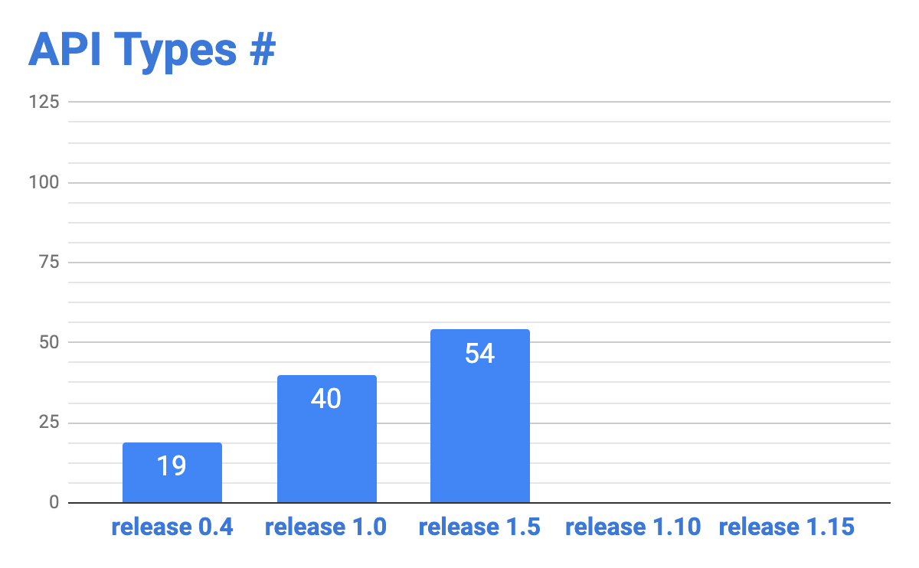
Kubernetes Growth
Notes:
Xing: To check how fast Kubernetes has been growing, we use # of API types inside the core as metrics to measure the growth rate.
In release 0.4, there were only 19 API types. Since then, it has doubled and tripled.
Anyone want to guess how many API types were in release 1.10?
-----------------------------------------------------------
Do you know how fast
To check how fast Kubernetes has been growning, we use # of API types inside the core the measure the growth rate.
TODO: check #
Use API types as metrics to measure how far k8s can grow
20 APIs in 1.0 to > 100 APIs in 1.15
More controllers needed to support them
It doubled and trippled

Slide 11
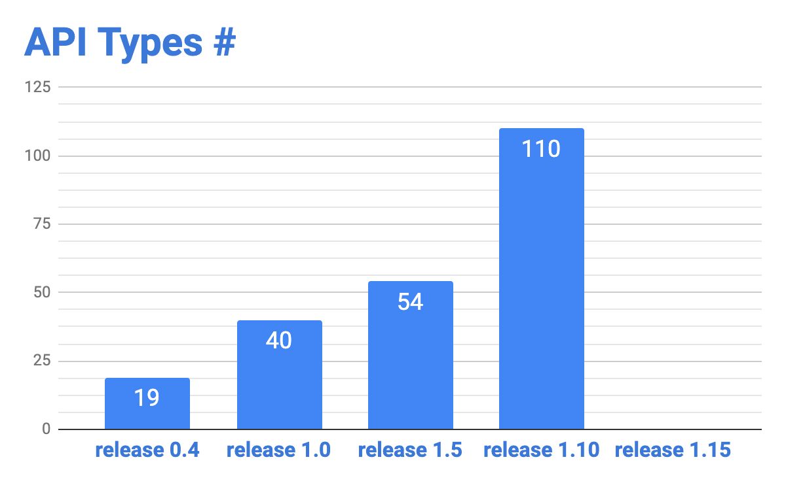
Kubernetes Growth
Notes:
Xing: It’s 110, that is almost 6 times as many as what we had in release 0.4

Slide 12

Kubernetes Growth
Notes:
With this growth rate, can you guess how many API types are in the latest release 1.15? We’ll let you know the answer later.

Slide 13
Kubernetes Giant？
Endpoints
Deployment
Namespace
Persistent
Volume
Kubernetes “Core”
Notes:
Xing: Are we expecting k8s to become a scary k8s Giant? How can we possibly manage and maintain this giant?
-------------------------------
The Kubernetes API aims for clean generality, and intentionally avoids becoming a warehouse for application specifics. Instead, the system provides a facility for extending the API with new and specific kinds of resources required to automate management of particular applications.
The k8s boat will become overloaded, can’t move fast

Slide 14

Kubernetes Giant？
Endpoints
Deployment
Namespace
Persistent
Volume
Kubernetes “Core”
Notes:
Xing: Obviously, we can’t. It is time to put a stop and say no more. We cannot keep adding new APIs to k8s core like this.
---------------------------------------
The Kubernetes API aims for clean generality, and intentionally avoids becoming a warehouse for application specifics. Instead, the system provides a facility for extending the API with new and specific kinds of resources required to automate management of particular applications.
The k8s boat will become overloaded, can’t move fast

Slide 15

Makes Kubernetes truly modular, extensible, and maintainable with a minimum “CORE”.
Notes:
Xing: Instead, From the architecture’s point of view, what we need to do is to make sure Kubernetes is truly modular, easy to extend to build new features,
and easy to maintain with a minimum “core”.
--------------------------------------------------------------
https://www.edutopia.org/blog/teaching-students-to-be-visionary-curriculum-stacey-goodman
makes Kubernetes truly modular, extensible, and maintainable with a minimum “core”.
Custom Resource Definitions are part of a wider effort to refine and enhance Kubernetes as an extensible application platform, factoring everything but the bare essentials out of “core” Kubernetes in favor of modular and maintainable extensibility mechanisms.
https://coreos.com/blog/custom-resource-kubernetes-v17

Slide 16

CRD Comes to the Rescue?
Makes Kubernetes truly modular, extensible, and maintainable with a minimum “CORE”.
Notes:
Xing: How can we achieve this goal? Now Jing is going tell us how CRD comes to the rescue.
-----------------------------------------

Slide 17
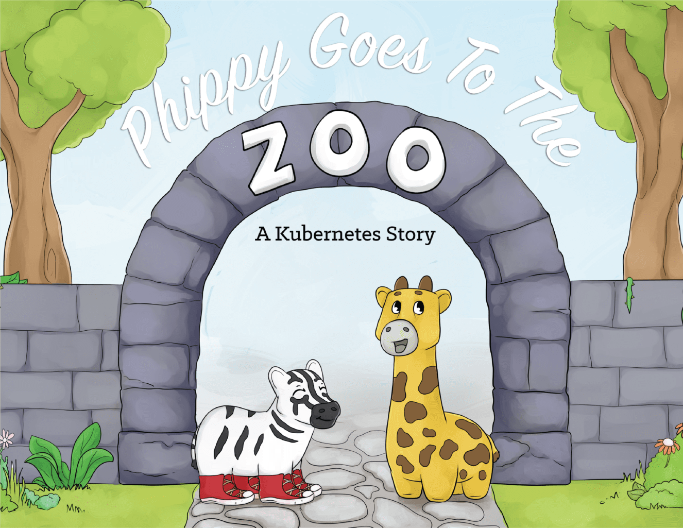
CRD: Define as You Like
What is CRD?
Kubernetes Children’s Book
Notes:
2.5
Jing 0.5
To explain CRD, I want to use Kubernetes Children’s book.
First we need to understand what is CRD. We borrowed this from children’s book. They explained these concepts to children in this interesting way so we want to share with you.
https://www.cncf.io/phippy-goes-to-the-zoo-book/
https://kubernetes.io/docs/concepts/extend-kubernetes/api-extension/custom-resources/
https://www.bmc.com/blogs/kubernetes-crd-custom-resource-definitions/
A custom resource is an extension of the Kubernetes API.
CustomResourceDefinition (CRD) API resource allows you to define custom resources.
The Kubernetes API serves and handles of storage of custom resource.
A custom controller allows you to manage custom resources and provides a true declarative API.

Slide 18
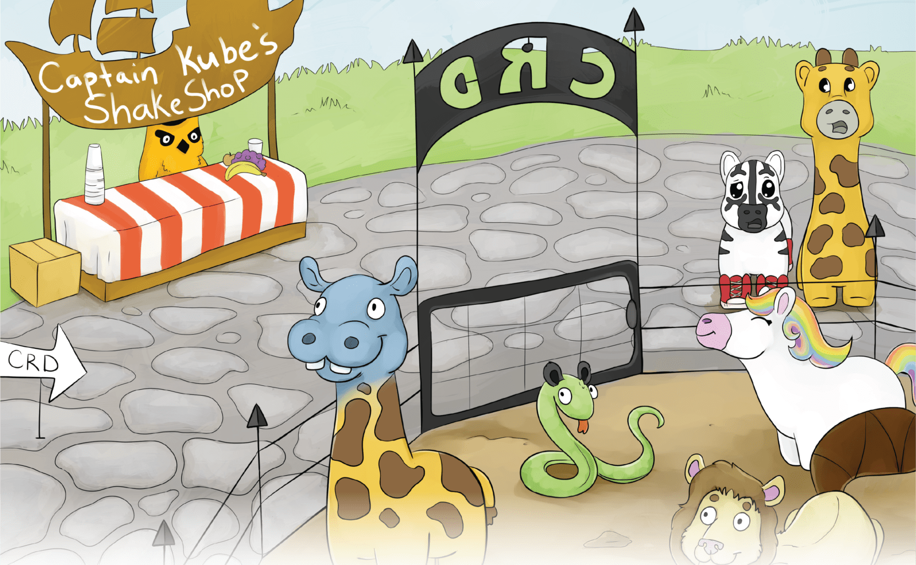
CRD Explained
CRD: Define as You Like
Kubernetes API Zoo
Notes:
Jing 0.5
Image k8s has a zoo with lots of animals. They all have API to represent them. And controller to monitor and control their behaviors.
Kids always want something new and funny, so we keep adding new animals into the zoo. How about some animal not existing,
We have custom resources to define them.
CRD is used to define the custom resources
https://www.cncf.io/phippy-goes-to-the-zoo-book/
https://kubernetes.io/docs/concepts/extend-kubernetes/api-extension/custom-resources/
https://www.bmc.com/blogs/kubernetes-crd-custom-resource-definitions/
A custom resource is an extension of the Kubernetes API.
CustomResourceDefinition (CRD) API resource allows you to define custom resources.
The Kubernetes API serves and handles of storage of custom resource.
A custom controller allows you to manage custom resources and provides a true declarative API.

Slide 19
CRD Explained
CRD: Define as You Like
R = Resource pod, statefulset, persistentvolume, ...
CR = Custom Resources pot, statelessset, nonpersistentvolume, ...
CRD = Custom Resources Definition
Kubernetes API Zoo
Notes:
Jing 0.5
Image k8s has a zoo with lots of animals. They all have API to represent them. Called resources
Kids always want something new and funny, not existing,
We have custom resources to define them.
CRD is used to define the custom resources
https://www.cncf.io/phippy-goes-to-the-zoo-book/
https://kubernetes.io/docs/concepts/extend-kubernetes/api-extension/custom-resources/
https://www.bmc.com/blogs/kubernetes-crd-custom-resource-definitions/
A custom resource is an extension of the Kubernetes API.
CustomResourceDefinition (CRD) API resource allows you to define custom resources.
The Kubernetes API serves and handles of storage of custom resource.
A custom controller allows you to manage custom resources and provides a true declarative API.

Slide 20

Example:
CRD
CR
apiVersion: apiextensions.k8s.io/v1beta1
kind: CustomResourceDefinition
metadata:
name: pandas.animals.zoo.k8s.io
spec:
scope: Namespaced
group: animals.zoo.k8s.io
version: v1alpha1
names:
kind: Panda
plural: pandas
apiVersion:animals.zoo.k8s.io/v1alpha1
kind: Panda
metadata:
name: qiqi
spec:
birthDay: 7/17/2018
birthPlace: Shanghai
birthWeight: 6
Notes:
Jing 1
Every kid loves Panda so we want to add Panda to the CRD zoo.
Left: a new CRD panda
Right: define panda resource spec

Slide 21
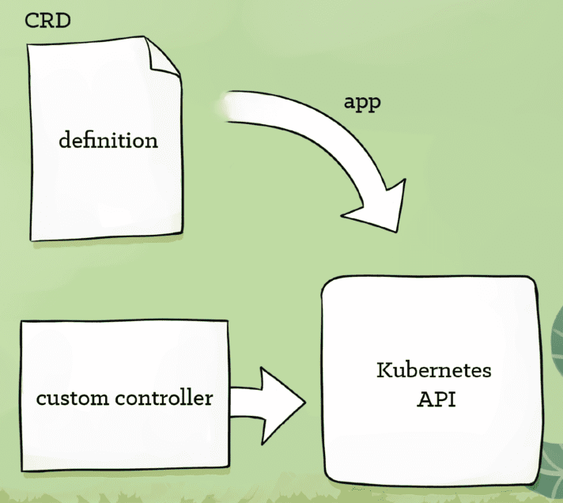
Define as You Like
CRD
+ Custom Controller
Declarative API
Notes:
Jing 1
Panda CRD does not do anything until you have a controller
Crd +controller, we get a declarative API which is what CRD all about.
CRD defines your desired state, controller will be working on trying to move actual state to desired state
From user side, they use this CRD the same way as other K8S API.
https://www.cncf.io/phippy-goes-to-the-zoo-book/
https://kubernetes.io/docs/concepts/extend-kubernetes/api-extension/custom-resources/
A custom resource is an extension of the Kubernetes API.
CustomResourceDefinition (CRD) API resource allows you to define custom resources.
The Kubernetes API serves and handles of storage of custom resource.
A custom controller allows you to manage custom resources and provides a true declarative API.

Slide 22
Back to Our CRD Journey ...
Notes:
Jing: Xing, do you want to finish our snapshot story?
Xing: Sure. Now we understood better why sig-architecture pushed snapshot API out of core and how CRD can help us extend kubernetes API.
We started to work on the snapshot feature.

Slide 23
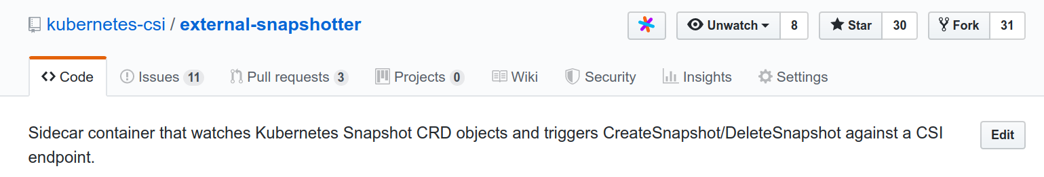
Back to Our CRD Journey ...
Notes:
Xing: We created a new repo out of tree under Kubernetes-csi

Slide 24
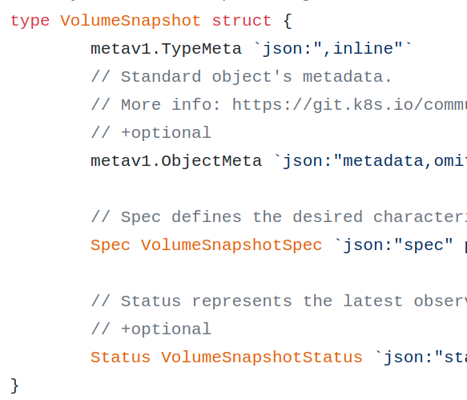
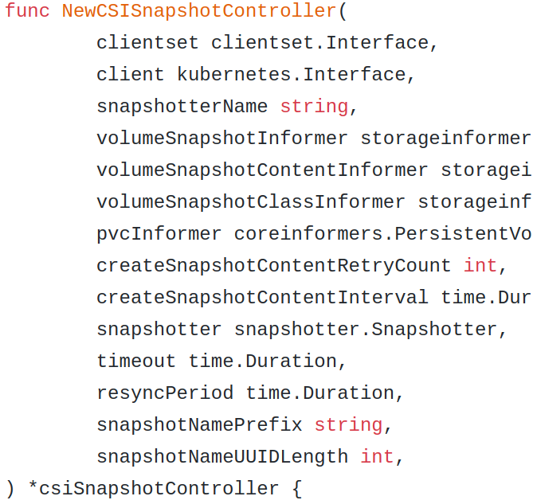
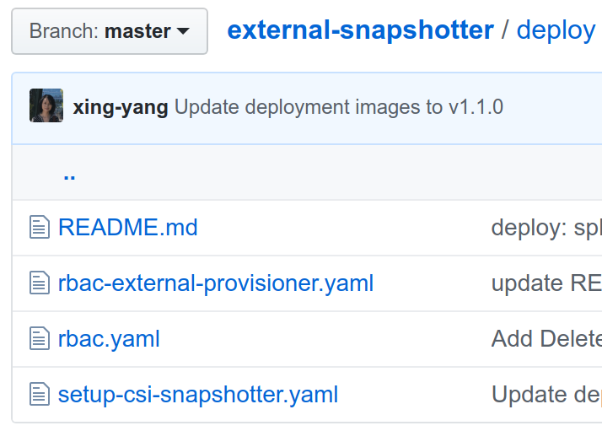
Back to Our CRD Journey ...
CRD
Controller
Deployment
Notes:
Xing: We added CRD definitions, created a snapshot controller to watch the snapshot API objects, and added deployment yaml files and documentation.
There are lots of details here, but as a user, you don’t really need to know

Slide 25
The Same Old User Experiences
APIs
kubectl create -f snap.yaml
kubectl delete -f snap.yaml
kubectl get volumesnapshot
kubectl list volumesnapshot
…
Volume Snapshot
PV
PVC
Core
Volume Snapshot Content
Pod
Node
Snapshot
Class
Notes:
Xing: From a user’s point of view, it works the same as any other k8s APIs
We already have core APIs PV/PVC, Pod, Node, and so on
Now we have also added Snapshot APIs to the API family
You can just use it the same old way, use kubectl create to create a snapshot API object, and use kubectl delete to delete it
Our snapshot controller will be working hard behind the scene to make sure user’s request is taken care of.

Slide 26


CRD vs. Native API
CRD is Beta
GA targeting in 1.16/1.17
Feature Parity
A long list …
Webhook admission controller
Multi-versioning
Subresource: Scale and Status
Quota support
OpenAPI v3 schema definition
Notes:
Xing: Now you might wonder Does that mean CRD is exactly the same as native API? Well, we have to say that there are still differences.
Currently CRD is still Beta. The plan is to bring it to GA in the next couple of releases.
CRD already supports many features available in the native API, such as Defaulting, validation, OpenAPI v3 schema definition, and so on
There is an effort to bridge the gap between the two.
CRDs are becoming more and more like native APIs.
--------------------------------
(CRD supports webhooks for mutation and validation. It allows default values to be set and validates if an API object meets certain requirements.
It supports OpenAPI v3 schema definition and brings a declarative API experience.
It supports multi-versioning, scale and status sub-resource.
Basic quota support is also added.)
Webhook admission controller
Mutating webhook: used to mutate a core API object or a CRD instance before the API server admits it. (defaulting)
Validating webhook: used to validate if an object meets certain requirements.
Multi-versioning
Subresource: Scale and Status
Quota support
OpenAPI v3 schema definition
OpenAPI Specs – Towards Native User Experience of CRDs - Stefan Schimanski, Red Hat
Target CRD GA in 1.16/1.17
OpenAPI structural schema (beta in 1.15)
OpenAPI publishing (beta in 1.15)
Conversion webhooks (beta in 1.15)
Introduced in 1.13 as alpha
Pruning (beta in 1.15)
Defaulting via Open API schema (alpha in 1.15)
Unions
Native API Features are being added to CRDs
https://kubernetes.io/docs/concepts/extend-kubernetes/api-extension/custom-resources/
https://kubernetes.io/docs/concepts/extend-kubernetes/api-extension/custom-resources/#advanced-features-and-flexibility
https://kubernetes.io/docs/tasks/access-kubernetes-api/custom-resources/custom-resource-definitions/
https://godoc.org/github.com/kubernetes-sigs/controller-runtime/pkg
OpenAPI Schema:
Q: Is there an OpenAPI (swagger) schema for the types that can be dynamically fetched from the server? Is the user protected from misspelling field names by ensuring only allowed fields are set? Are types enforced (in other words, don’t put an int in a string field?)
Ar: No, but planned
Versioning:
https://kubernetes.io/docs/tasks/access-kubernetes-api/custom-resources/custom-resource-definition-versioning/

Slide 27

VolumeSnapshot (CRD) is part of Kubernetes
Sig-Storage Ownership
End to End Testing
Official Documentation
Notes:
Xing: VolumeSnapshot CRD is part of Kubernetes.
It is owned by a sig-storage, it has end-to-end testing, and official documentation.
User can use snapshot as other k8s storage features, like persistent volumes.
More and more CSI drivers have implemented the snapshot feature.
And People have also started to build advanced data protection and disaster recovery functions on top of it.
Now you have heard our story. We have successfully added snapshot CRD out of tree as Kubernets Core feature.
Jing. Great!, our story finally have a happy ending. Now you might want to try it out yourself.

Slide 28
CRD: Define as You Like
I want to create CRD for
Notes:
1 1/3min
Jing 0.5
Story has Happy ending
We are going to show you an example to add our cute Panda to the k8s zoo.
We’ve talked a lot about CRDs. Can we show an example of creating an CRD for Panda?
https://www.cncf.io/phippy-goes-to-the-zoo-book/
https://kubernetes.io/docs/concepts/extend-kubernetes/api-extension/custom-resources/
https://www.bmc.com/blogs/kubernetes-crd-custom-resource-definitions/
A custom resource is an extension of the Kubernetes API.
CustomResourceDefinition (CRD) API resource allows you to define custom resources.
The Kubernetes API serves and handles of storage of custom resource.
A custom controller allows you to manage custom resources and provides a true declarative API.

Slide 29

Build CRD
Create a project with kubebuilder init
Define a new API with kubebuilder create api
Build and run the provided main function with make install & make run
Notes:
Jing 0.5
To be honest, it is not easy if you manually do lots of steps from scratch.
Good news we have several tools to help you. Here we use Kubebuilder as an example.
Building CRD is as easy as 1, 2, 3, using the SDK called kubebuilder
With these 3 commands, you can already have a basic CRD and controller.
To prove what we are saying is true, we are going to show a demo.
First create a project with “kubebuilder init”
then define a new API,
Add CRD definitions and modify controller logic.
Run Make install to install the CRD
And make run to start the controller manager.
https://medium.com/faun/intro-to-kubebuilder-how-to-guide-for-building-custom-kubernetes-apis-using-crds-operators-6b8213f6dcc4
Kubebuilder is a framework for building Kubernetes APIs using custom resource definitions (CRDs).
Kubebuilder is an SDK for quickly and easily building and publishing Kubernetes APIs in Golang

Slide 30


How to Build Panda CRD and Controller in two minutes !!!
Ti Gong
“Little Princess” Qi Qi - “公主仔” 七七
Notes:
Jing 0.5
To prove we are not lying, we want to show you a demo
Shanghai ppl might know this Panda, name 77. We are going to add her to the zoo
We will define a CRD for her, and write a controller to monitor her growth using Kubebuilder.
Now Xing will show you how to do all of these in just two minutes!

Slide 31
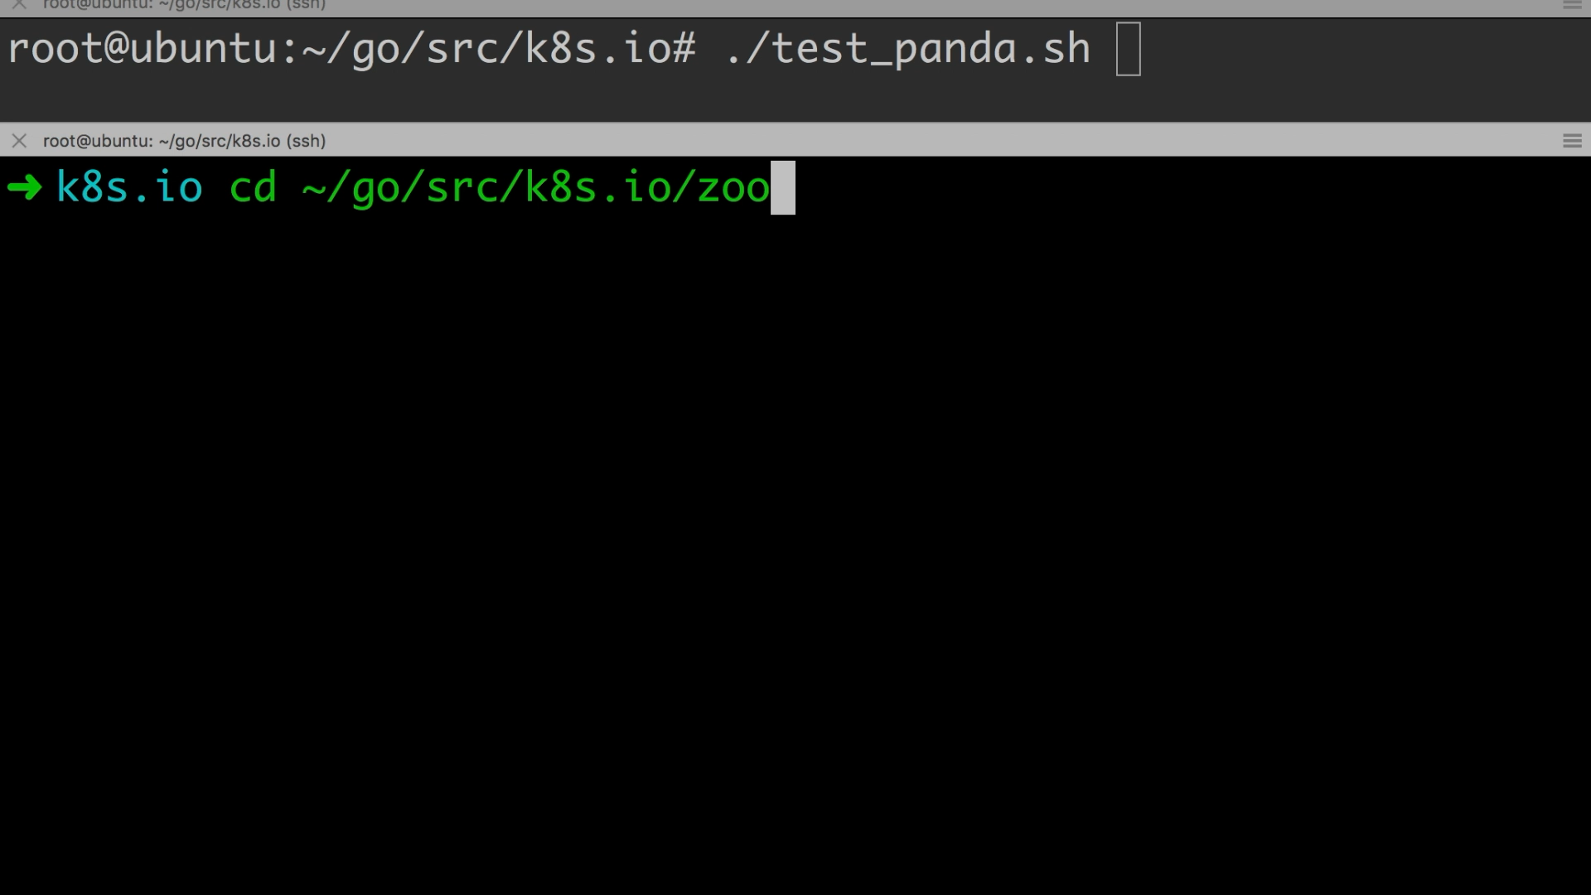
Placeholder for the Demo
This page will be replaced by an embedded demo
Notes:
2 min
Xing
Jing, Great!, we did in two minutes. Before finishing our talk, we want to show you history.

Slide 32

CRD’s Evolution
Third Party Resource (TPR)
Prototyping
~1.2 Release
~1.7 Release
~1.12 Release
Notes:
2
Jing ⅓
Great! We have just proved that we can finish it in two minutes with although not three, but six steps. But you get the point, right. Before finishing this topic,we want to go over some of CRD history to have a more complete picture of it.
CRD is an evolution of an older feature called Third Party Resources. Many people has great ideas they want to try it on kubernetes, but it is almost impossible without adding new API to the core first. And at the same time, we cannot accept all requests without some proof. TPR allows developers to test, Prototyping their ideas outside of kubernetes without touching the core. It sounds great! But at that time TPR also has a number of limitations which makes it easy and reliable to use. The newer version, which we call CRD now, has largely addressed those limitations, and many users start to use it to build application operator to control their specific application logic. Today we just showed that how we could use CRD to extend kubernetes core API. With this great tool in our hand, we no longer need to worry about seeing that Scary kubernetes Giant any more, instead what we are going to see is this
TPR suffered from a bunch of limitations that were addressed with CRD starting with version 1.7, most notably its inability to validate new/updated resources (which will be stored, as is in etcd, even if they are malformed).
We have shown you how to build CRD and controller
It is 6 steps, not 3, but you get the point. It is very easy to build CRD and controller.
We want to dig deeper into CRD history to better understand it.

Slide 33
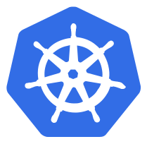

CRD’s Evolution
MySQL Cluster
MySQL Operator
MySQL
MySQL
MySQL
Third Party Resource (TPR)
Prototyping
Custom Resource Definition (CRD)
Application operator
~1.2 Release
~1.7 Release
~1.12 Release
Notes:
2
Jing 1/3
We have shown you how to build CRD and controller
It is 6 steps, not 3, but you get the point. It is very easy to build CRD and controller.
We want to dig deeper into CRD history to better understand it.

Slide 34
CRD’s Evolution
APIs
MySQL Cluster
Core
MySQL Operator
MySQL
MySQL
MySQL
Third Party Resource (TPR)
Prototyping
Custom Resource Definition (CRD)
Application operator
Extending Core API
~1.2 Release
~1.7 Release
~1.12 Release
Notes:
2
Jing 1/3
We have shown you how to build CRD and controller
It is 6 steps, not 3, but you get the point. It is very easy to build CRD and controller.
We want to dig deeper into CRD history to better understand it.

Slide 35
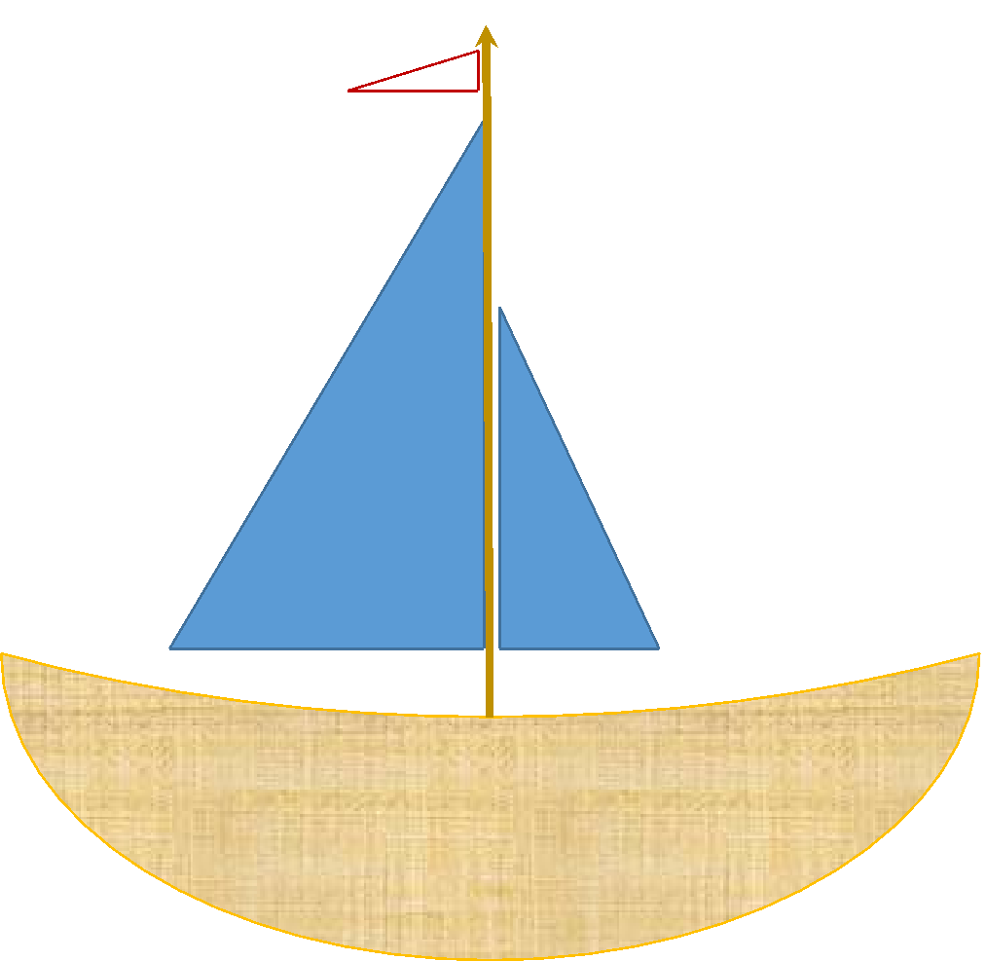
Kubernetes Fleet
VolumeSnapshot
ApplicationSnapshot
Kubernetes “Core”
VolumeGroup
ExecutionHook
Notes:
Jing 0.5
Very cool Kubernetes fleet.
Dont worry about becoming
Using this way to extend k8s API, image we can have a k8s fleet, instead of a k8s giant.
Maintain individual k8s features, instead of a giant k8s core.

Slide 36
Kubernetes Growth
Notes:
Jing: Now, remember we ask you to guess the number of API TYPE in latest release 1.15, Xing, do you want to give us the answer?
Xing: yes. It is 113. Did anyone get the right number?

Slide 37
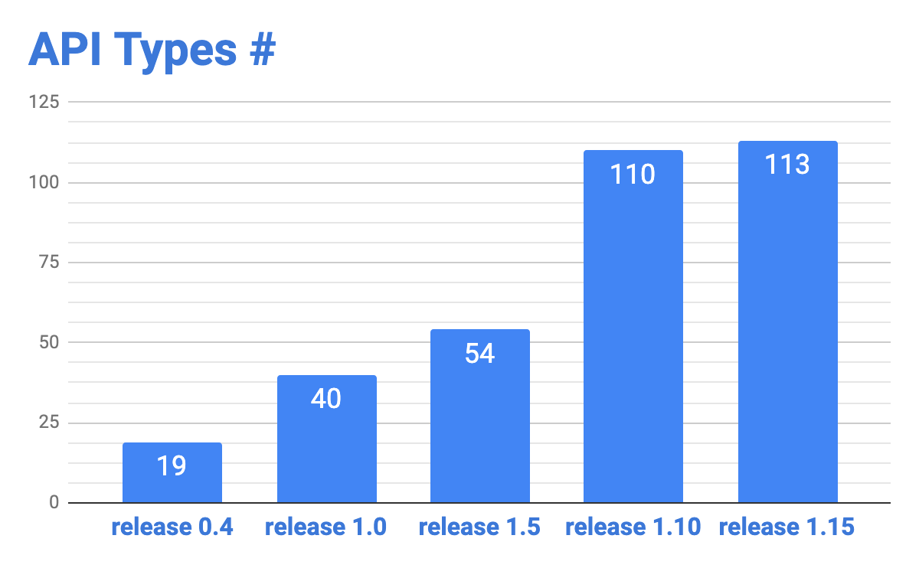
Kubernetes Growth
Notes:
It is almost the same as release 1.0. That means sig-architecture already started to restrict the number of APIs added to the core.

Slide 38

We Have a Vision
“Everything is CRD
… except things to run CRD”
Tim Hockin
Notes:
Xing: Now let’s look further into the future. We have a vision. This is from Tim Hockin, the Kubernetes Pioneer.
He said that Eventually Everything becomes a CRD (except things to run CRDs)
----------------------------------
How about we move everything out of tree, we make Node, Pod as CRDs
We only keep APIs that are absolutely necessary to run CRDs in-tree, such as namespace.
Here’s a quote from Tim Hockin, a K8S Pioneer. He said in his lightening talk that “...”
There are API objects that started as alpha in CRDs but moved back to in-tree as beta APIs.
CSIDriver
CSINode
RuntimeClass
Talk about our experience using CRDs to build a core K8s Feature
A basic building block for more advanced data services

Slide 39

We Have a Vision
“Everything is CRD
… except things to run CRD”
Tim Hockin
Notes:
Xing: Of course it is still a long way to go to realize this vision.
There are version compatibility issues between k8s core and CRD, installation of CRDs is still a separate step,
we also need to figure out how to better handle CRD’s dependency on k8s core, and so on.
But we hope that, with hard work, eventually we will get there.
------------------------------------------------------------------------------
-----------------------------------------------------------
There are API objects that started as alpha in CRDs but moved back to in-tree as beta APIs.
CSIDriver
CSINode
RuntimeClass
Talk about our experience using CRDs to build a core K8s Feature
A basic building block for more advanced data services

Slide 40
Resources
CRD
Kubernetes.io https://kubernetes.io/docs/concepts/extend-kubernetes/api-extension/custom-resources/
CRD Tools
Kubebuilder book https://book.kubebuilder.io/
Operator SDK https://github.com/operator-framework/operator-sdk
MetaController https://metacontroller.app/
VolumeSnapshot
Snapshotter Repo https://github.com/kubernetes-csi/external-snapshotter
Kubernetes.io https://kubernetes.io/docs/concepts/storage/volume-snapshots/
Notes:
0.5
Now

Slide 41

Acknowledgement
sig-architecture
api-machinery
Kubernetes community
sig-storage

Slide 42




Join us
jingxu97 & xing-yang
jinxu & xyang
jinxu@google.com & xingyang105@gmail.com

Slide 43
Notes:
Twitter:

